Slide 1
Centroids of Volumes and the Center of Mass via Integration
Dr. Jacob Moore
Associate Professor of Mechanical Engineering
Penn State Mont Alto

Slide 2
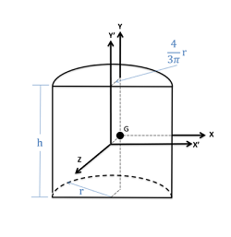
Centroid of a Volume
The centroid of volume is the geometric center of that shape.
It will have an x, y, and z coordinate.
There is equal volume to the left and right of this point.
There is equal volume above and below this point
There is equal volume in front of and behind this point.
C

Slide 3
Center of Mass
The center of mass of a body is the center point when averaged by mass.
There is equal mass to the left and right of this point.
There is equal mass above and below this point
There is equal mass in front of and behind this point.
In cases where the body has a uniform density, the centroid and center of mass will be the same point.
G

Slide 4
Practical Uses for the Centroid and Center of Mass
The centroid of a volume is not used very frequently in mechanics courses, however knowing the center of mass will be useful in most instances when there are gravity forces involved.
Gravity is a distributed force, however we will often simplify gravity into a point force that acts at the center of gravity.

Slide 5
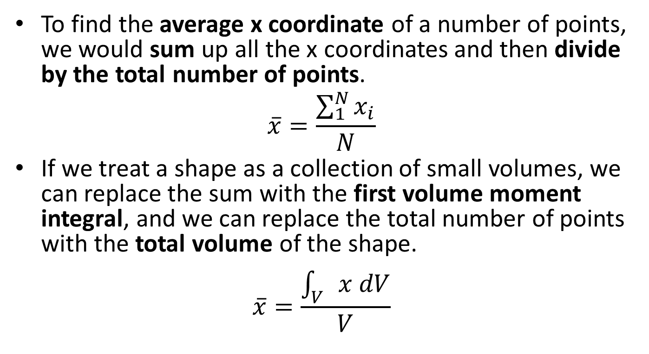
Finding the Centroid of a Volume via Integration
To find the average x coordinate of a number of points, we would sum up all the x coordinates and then divide by the total number of points.
$$\overline{x}=\frac{\sum_{1}^{N}{x_{i}}}{N}$$
If we treat a shape as a collection of small volumes, we can replace the sum with the first volume moment integral, and we can replace the total number of points with the total volume of the shape.
$$\overline{x}=\frac{\int_{V}{x dV}}{V}$$

Slide 6
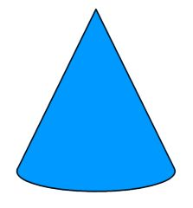
Finding the Centroid
The equation describing the cross sectional area of the shape at any given value of z
z
The z position of the topmost point on your shape
z max
$$\overline{z}=\frac{\int_{z min}^{z max }{dV∗z}}{V}$$
$$dV$$
z min
y
The z position of the centroid
The total volume of the shape
x
The z position of the bottommost point on your shape

Slide 7
Centroid of a Volume
Where the rate of change of the area (dA) was equal to the height of the shape at any given value of x times dx, the rate of change of the volume (dV) is equal to the area at any given value of x times dx.
This means that we will need to find a formula that describes the area for a cross section at any given value of x (this cross section will be perpendicular to the x axis).
Find the general shape of the cross section and relate try to relate the shape characteristics (base, height, radius, etc.)

Slide 8
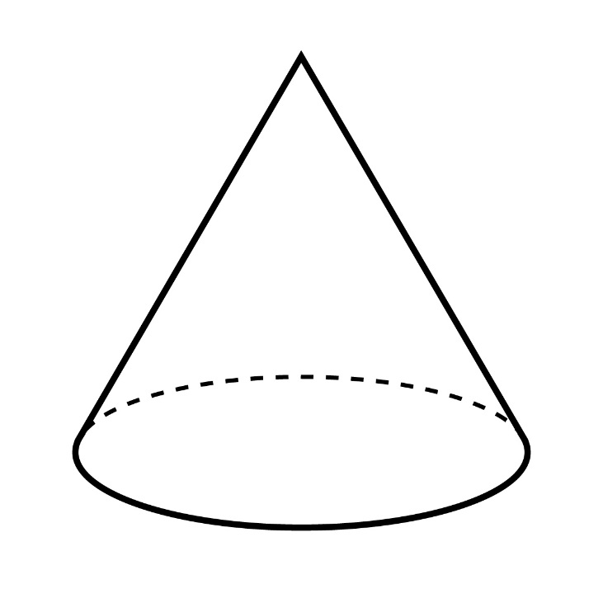
Centroid of a Volume
For bodies that are symmetrical about a particular plane, we can take a shortcut in finding the centroid.
The centroid will simply lie along the plane of symmetry between the two halves.
This often saves having to carry out the integrals in some directions.
z
y
x

Slide 9
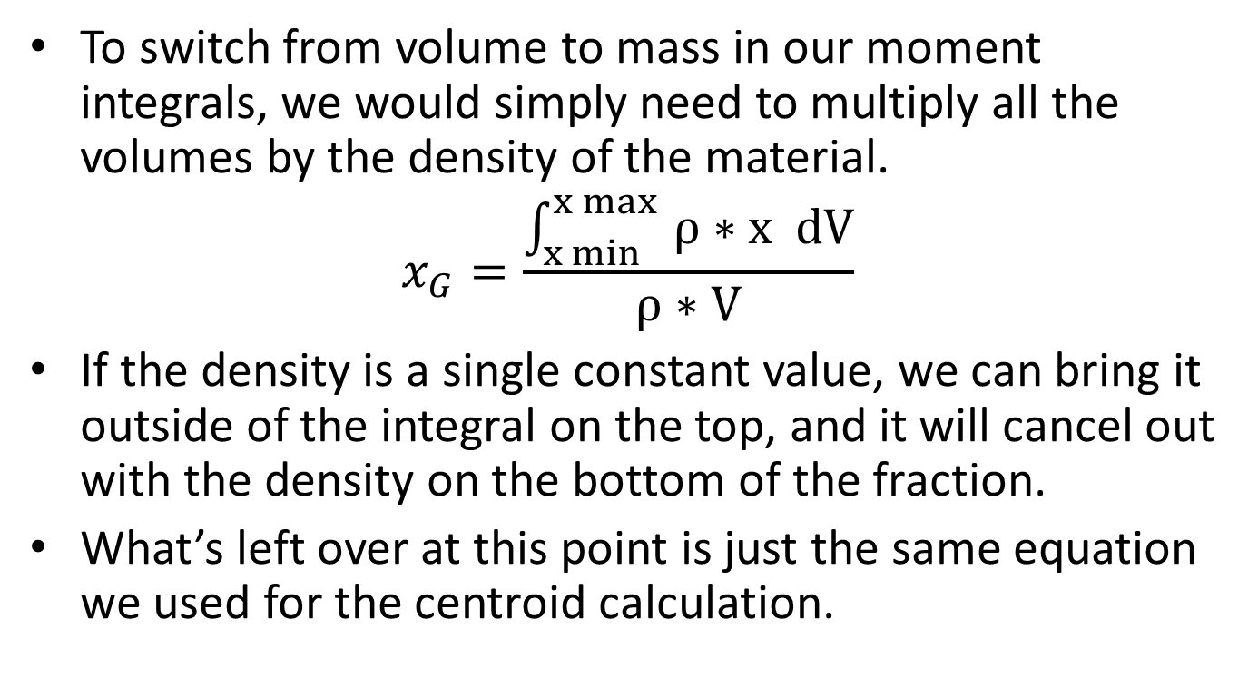
Finding the Center of Mass
To switch from volume to mass in our moment integrals, we would simply need to multiply all the volumes by the density of the material.
$$x_{G}=\frac{\int_{x min}^{x max }{ρ∗x dV}}{ρ∗V}$$
If the density is a single constant value, we can bring it outside of the integral on the top, and it will cancel out with the density on the bottom of the fraction.
What’s left over at this point is just the same equation we used for the centroid calculation.

Slide 10
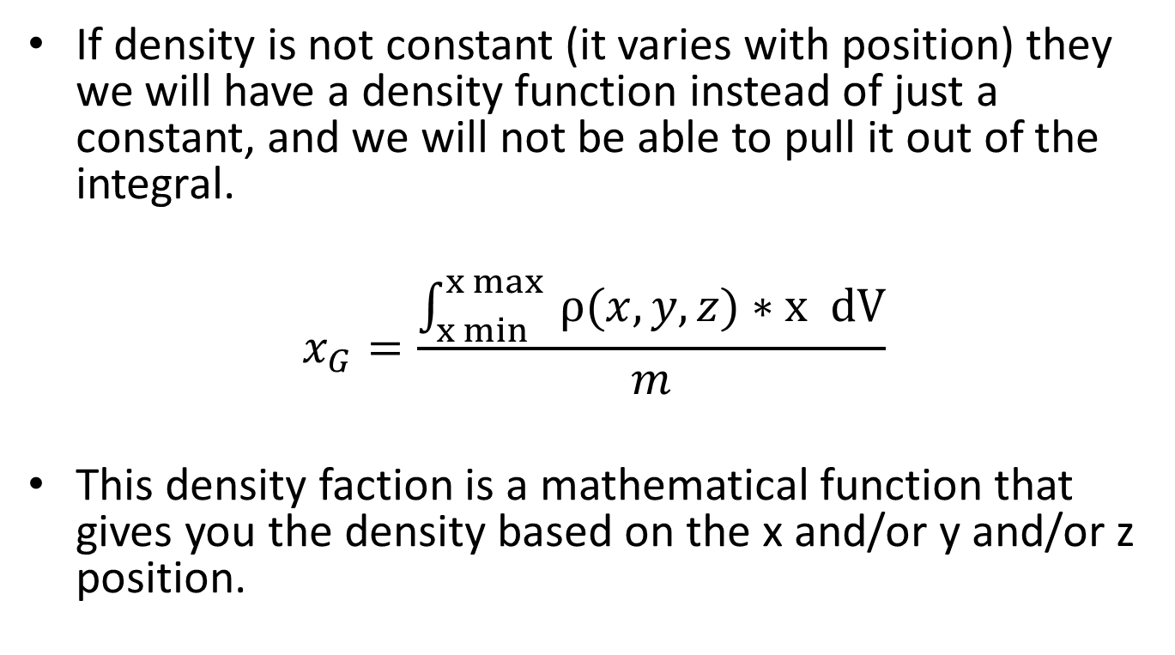
Finding the Center of Mass (non-uniform density)
If density is not constant (it varies with position) they we will have a density function instead of just a constant, and we will not be able to pull it out of the integral.
$$x_{G}=\frac{\int_{x min}^{x max }{ρ(x,y,z)∗x dV}}{m}$$
This density faction is a mathematical function that gives you the density based on the x and/or y and/or z position.

Slide 11
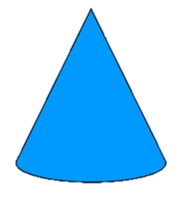

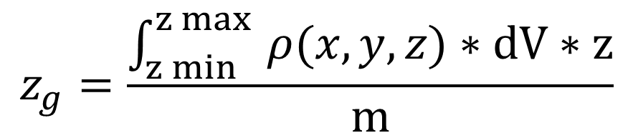
Finding the Center of Mass
The equation describing the density at any x, y, and z position
The equation describing the cross sectional area of the shape at any given value of z
z
The z position of the topmost point on your shape
z max
$$z_{g}=\frac{\int_{z min}^{z max }{ρ(x,y,z)∗dV∗z}}{m}$$
$$dV$$
z min
y
The z position of the center of mass
The total mass of the object
x
The z position of the bottommost point on your shape

Slide 12
Thanks for Watching
See other engineering mechanics videos and access the full tool at…

Slide 13
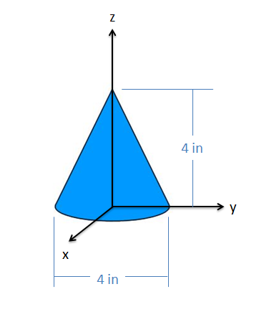
Centroid of a Volume Worked Example
The cone shown below is four inches tall and has a four inch diameter base. Find the x, y, and z coordinates of the centroid.

Slide 14
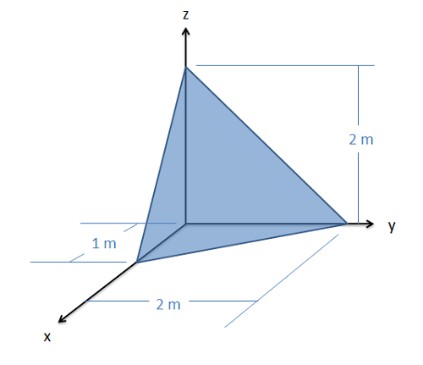
Cdentroid Worked Example
Find the y coordinate of the centroid for the tetrahedron shown in the image below. (The fourth vertex is at the origin)

Slide 15
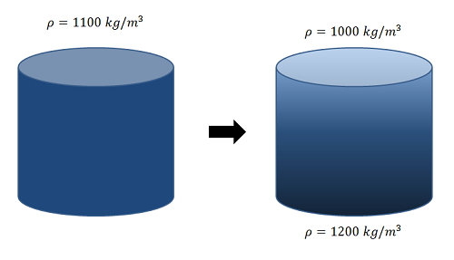
Center of Mass Worked Example
A water and ceramic slurry with a uniform density of 110 kilograms per meter cubed enters a settling tank with a height of one meter and a diameter of one meter. After one hour in the tank, the density of the slurry at the top of the tank is measured to be 1000 kilograms per meter cubed and the density at the bottom of the tank is measured to be 1200 kilograms per meter cubed. Assume the density of the slurry varies linearly between the top and the bottom. How far has the center of mass of the slurry dropped between the initial conditions and the current state?

